Slide 1

Measuring Sales Performance
using simple
Statistical Models

Slide 2

Price’s Law applied to a sales organization estimates that 50% of your sales performance will be attributed to the square root of the number of the salespeople

Slide 3

Regression to the mean can be applied to estimating a new salesperson's quota, which states that a salesperson will likely perform closer to the average of the overall sales team rather than being an outlier

Slide 4

Law of Large Numbers (Averages) states that after enough sales engagements consistent sales trends will begin to emerge that can be used to forecast future sales success goals

Slide 5

Simple statistical distributions like the negative binomial can be used to estimate the numerical count of required customer calls to attain a certain amount of successful sales

Slide 6


X
1 / 6 (16.7%) x 1 / 2 (50.0%) = 1 / 12 (8.3%)
Probability of rolling a 4 Probability of flipping heads

Slide 7
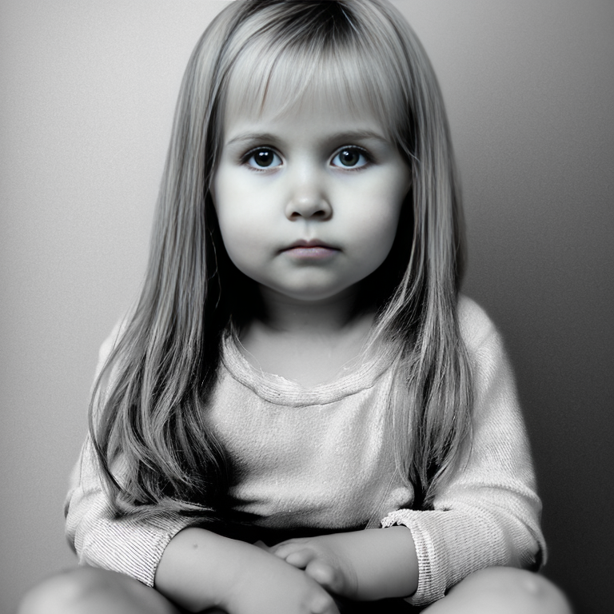


X
X
1/2 (50.0%) x 1/2 (50.0%) x 1/2 (50.0%) = 1/8 (12.5%)
Probability of “daughter” Probability of “daughter” Probability of “daughter”

Slide 8
Probability calculation of three daughters in family
Probability calculation of being able to create a full family & marriage
Probability of NO marriage divorce (USA, 10 years) - 68%
Probability of NO infertility in a couple - 85%
Probability of NO long-term job displacement - 94%
Probability of NO cataclysmic asteroid or comet impact (10 years) - 99.97%
Probability of NO World War 3 (10 years) - 95.1%
X
X
X
1/2 (50.0%) x 1/2 (50.0%) x 1/2 (50.0%) x 51.6% = 6.5%
Probability of “daughter” Probability of “daughter” Probability of “daughter” Probabilities of “selected independent events”

Slide 9
Probability calculation of all three daughters in family
Probability calculation of being able to create a full family & marriage
X
X
X
Probability of family with 3 or more children (*) 12.6%
X
Probability of family with both parents present (*)
72.9%
1/2 (50.0%) x 1/2 (50.0%) x 1/2 (50.0%) x 12.6% x 72.9% = 1.1%
Probability of “daughter” Probability of “daughter” Probability of “daughter” Probabilities of “selected US census data”
(*) Probability source data from United States Census Bureau - https://www.census.gov/

